Slide 1
EMOTION
Our emotional response to situations affects how we perform. For example, positive emotions enable us to think more creatively, to solve complex problems, whereas negative emotion pushes us into narrow, focussed thinking. A problem that may be easy to solve when we are relaxed, will become difficult if we are frustrated or afraid.
It suggests that in situations of stress, people will be less able to cope with complex problem solving or managing difficult interfaces, whereas if people are relaxed they will be more forgiving of limitations in the design. This does not give us an excuse to design bad interfaces but does suggest that if we build interfaces that promote positive responses for example by using aesthetics or reward – then they are likely be more successful.

Slide 2
INDIVIDUAL DIFFERENCES
We have made the assumption that everyone has similar capabilities and limitations and that we can therefore make generalizations. To an extent this is true: the psychological principles and properties that we have discussed apply to the majority of people. Notwithstanding this, we should remember that, although we share processes in common, humans, and therefore users, are not all the same. We should be aware of individual differences so that we can account for them as far as possible within our designs.
These differences should be taken into account in our designs. It is useful to consider, for any design decision, if there are likely to be users within the target group who will be adversely affected by our decision. At the extremes a decision may exclude a section of the user population.

Slide 3
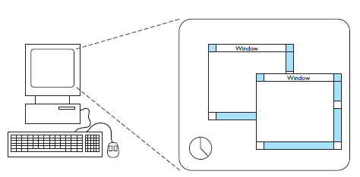
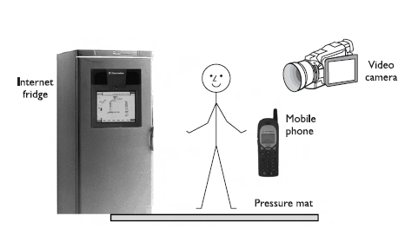

Slide 4
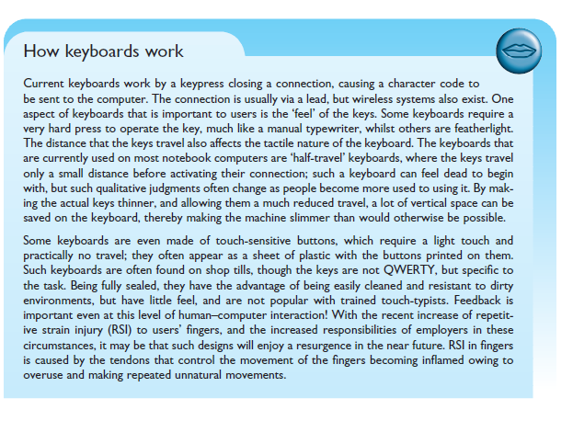
TEXT ENTRY DEVICES

Slide 5
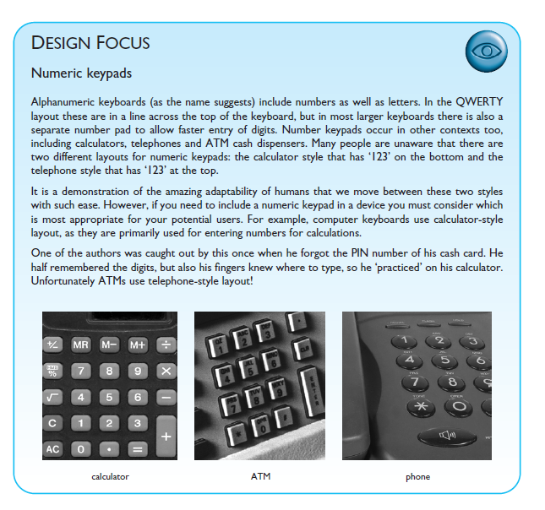

Slide 6
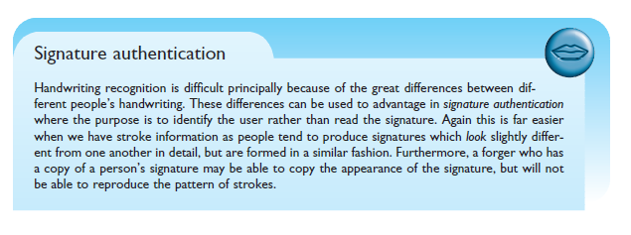
Handwriting recognition

Slide 7
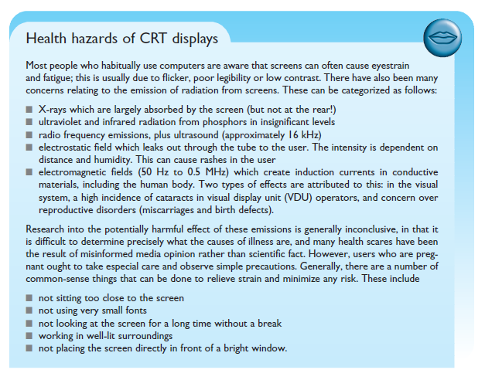
POSITIONING, POINTING AND DRAWING
The mouse, Touchpad, Trackball and thumbwheel, Joystick and keyboard nipple, Touch-sensitive screens (touchscreens), Stylus and light pen, Digitizing tablet, Eyegaze, Cursor keys and discrete positioning
DISPLAY DEVICES
Bitmap displays – resolution and color, Cathode ray tube, Liquid crystal display, Large displays and situated displays, Digital paper,

Slide 8
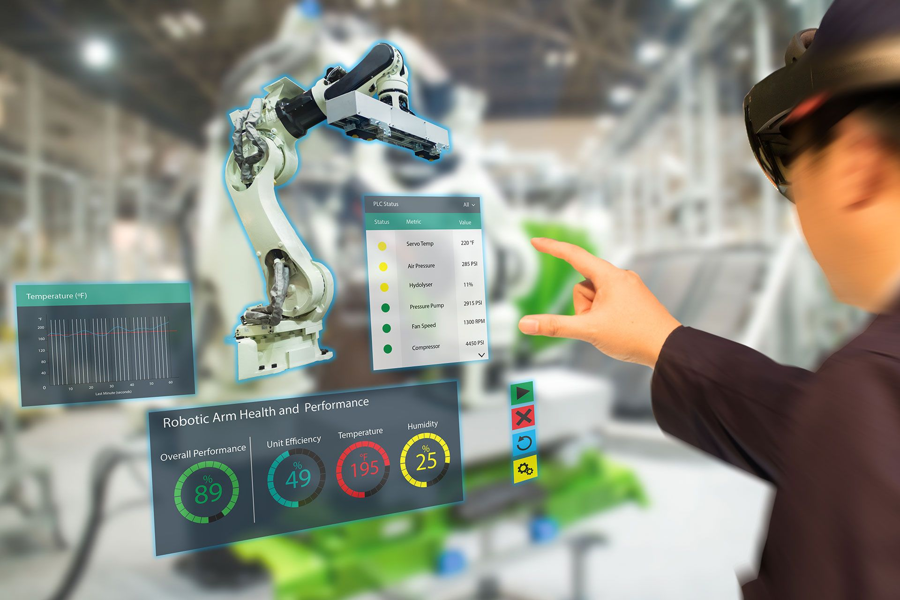

Slide 9
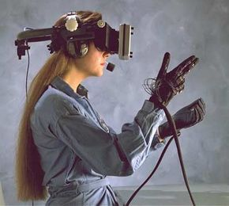

Slide 10
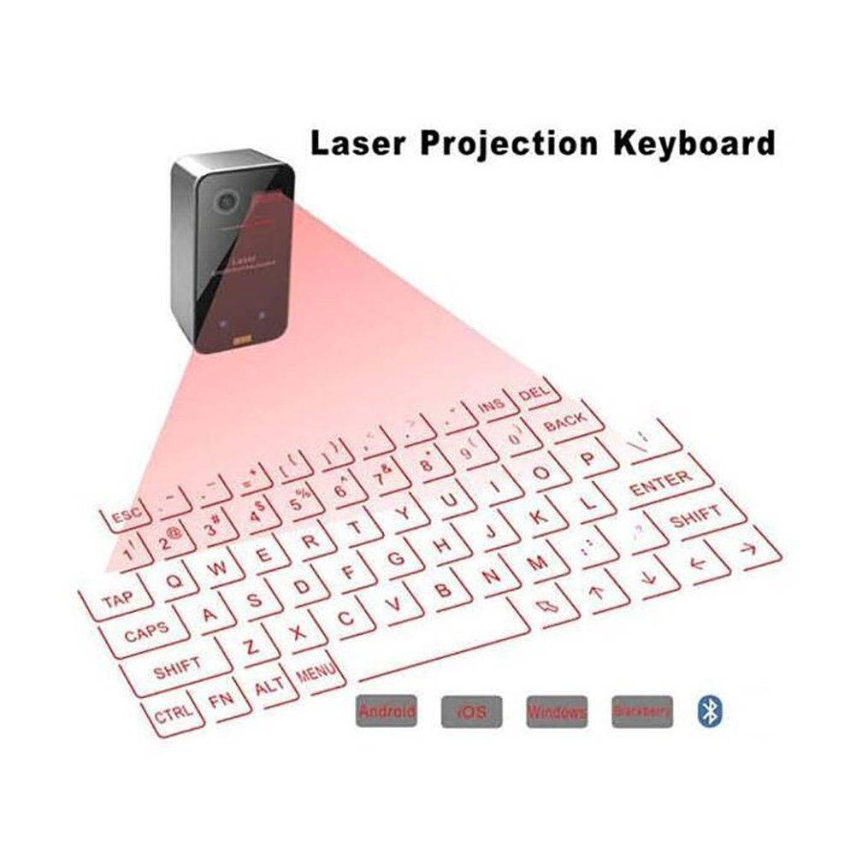

Slide 11
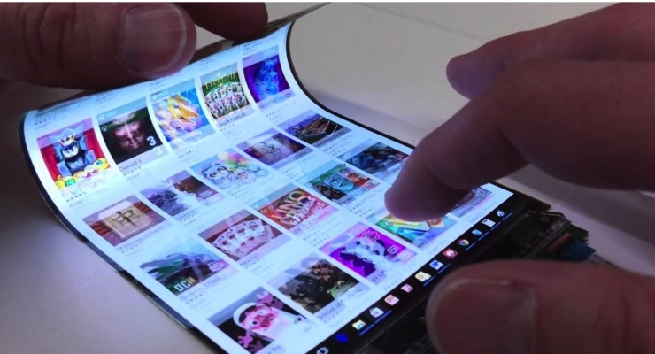

Slide 12
https://cis.unimelb.edu.au/hci/projects
https://hcii.cmu.edu/summer-research-program/projects
https://www.inf.uni-hamburg.de/en/inst/ab/hci/projects.html
https://infosci.cornell.edu/information/news/newsitem384/these-6-hci-projects-tackle-everyday-challenges

Slide 13
https://www.youtube.com/watch?v=J_oPtEjiVuA
https://www.youtube.com/watch?v=fABc88g0erA

